Slide 1
Airport
File created on: 17-01-2021 13:10:27

Slide 2
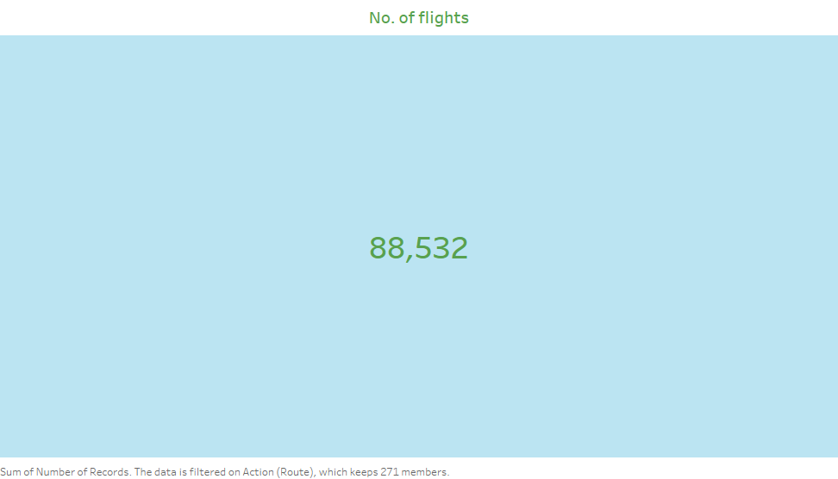

Slide 3
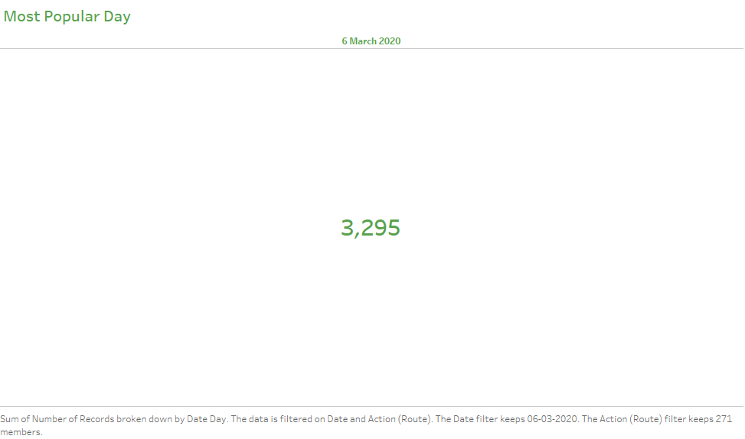

Slide 4
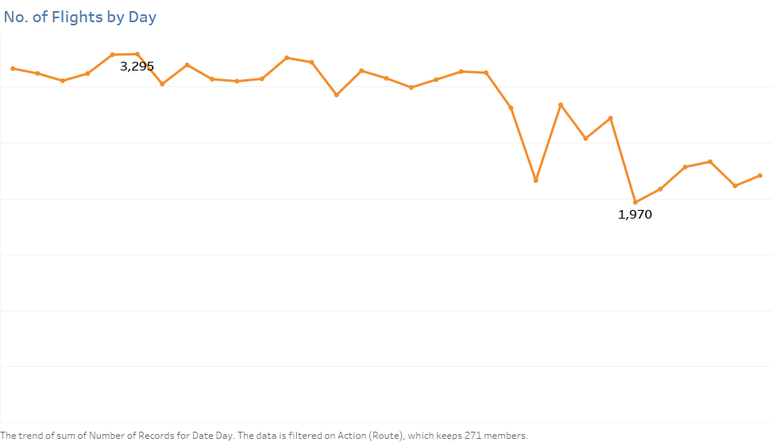

Slide 5


Slide 6


Slide 7
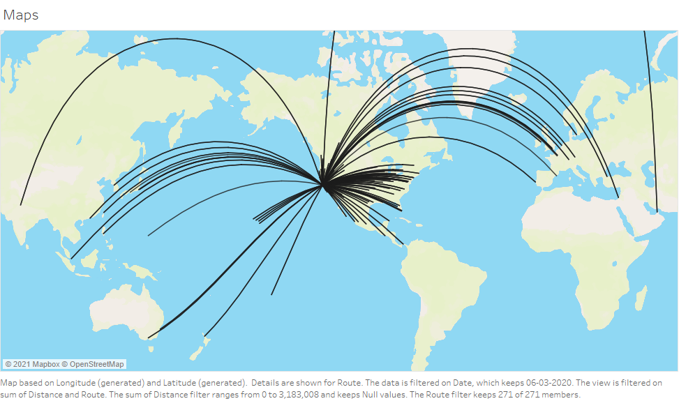

Slide 8
